Slide 1
Measures of central tendency
Mean, median, mode, weighted mean

Slide 2
Measures of central tendency versus measures of dispersion
Measures of central tendency
Measures of the location of the middle or the center of a distribution
Mean, median, mode
Measures of dispersion
Describe how the observations are distributed
Variance, standard deviation, range, etc

Slide 3
The mean for a sample versus the mean for a population
Mean – Most commonly used measure of central tendency
Average of all observations
The sum of all the scores divided by the number of scores
Sample mean:
Population mean:

Slide 4
Example
A sample of 10 trees randomly selected from a forest showed the following dimensions:
Diameter (inches):
9.8, 10.2, 10.1, 14.5, 17.5, 13.9, 20.0, 15.5, 7.8, 24.5
Find the mean for the sample:
inches
Note: The mean has the same units as the data in the sample or population.

Slide 5
Mean – a sensitive measure
Advantage
Includes all values in estimating the mean
Disadvantage
Very sensitive to outliers… What is an outlier?
No. | Tree Height (m) |  | No. | Tree Height (m)
1 | 5.0 |  | 6 | 5.3
2 | 6.0 |  | 7 | 7.1
3 | 7.5 |  | 8 | 25.4
4 | 8.0 |  | 9 | 7.5
5 | 4.8 |  | 10 | 4.5
Source: http://www.forestlearn.org/forests/refor.htm
Mean = 6.19 m Mean = 8.10 m

Slide 6
The median
Median – This is the value of a variable such that half of the observations are above and half are below this value i.e. this value divides the distribution into two groups of equal size
When the number of observations is odd, the median is simply equal to the middle value
When the number of observations is even, we take the median to be the average of the two values in the middle of the distribution

Slide 7
To determine the median, values have to be ordered in ascending order first
Example I
Data: 8, 4, 2, 6, 10 (mean: 6)
2, 4, 6, 8, 10
median: 6
Example II
Sample: 10 trees randomly selected from a forest
Diameter (inches):
9.8, 10.2, 10.1, 14.5, 17.5, 13.9, 20.0, 15.5, 7.8, 24.5 (mean: 14.38 inches)
7.8, 9.8, 10.1, 10.2, 13.9, 14.5, 15.5, 17.5, 20.0, 24.5
median: (13.9 + 14.5) / 2 = 14.2 inches

Slide 8
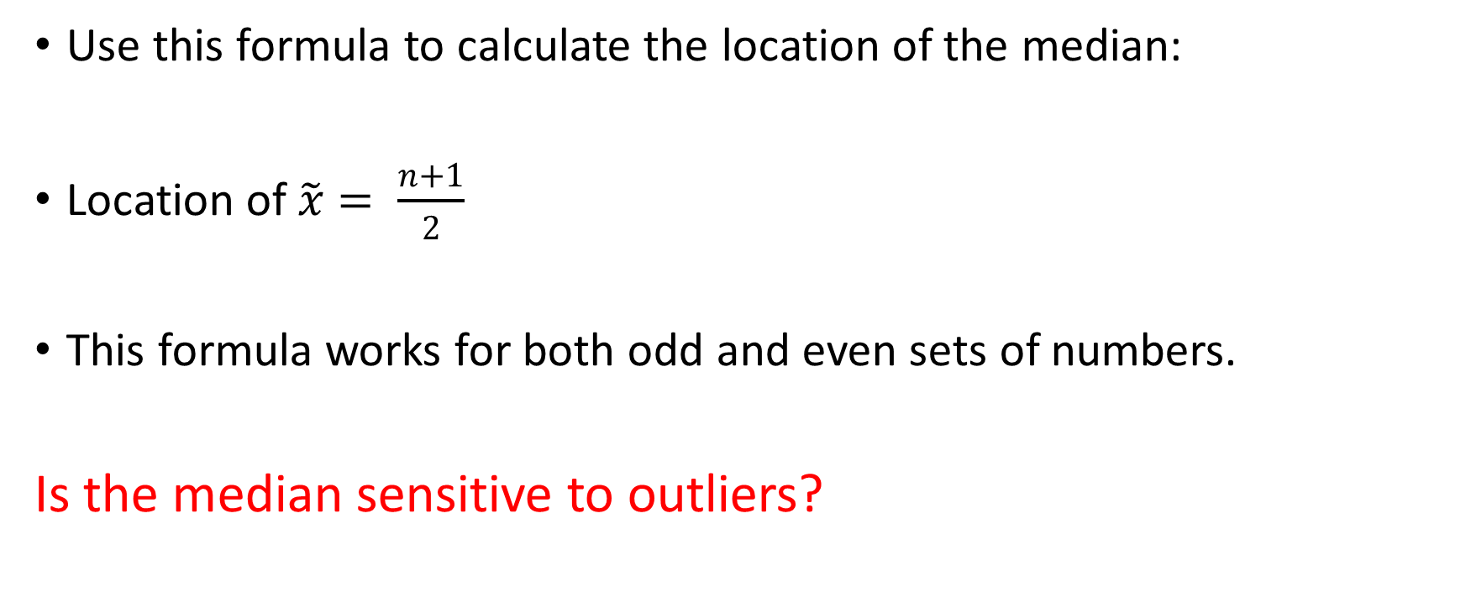
Formula for the location of the median
Use this formula to calculate the location of the median:
Location of $\tilde{x}= \frac{n+1}{2}$
This formula works for both odd and even sets of numbers.
Is the median sensitive to outliers?

Slide 9
No. | Tree Height (m) |  | No. | Tree Height (m)
1 | 5.0 |  | 6 | 5.3
2 | 6.0 |  | 7 | 7.1
3 | 7.5 |  | 8 | 25.4
4 | 8.0 |  | 9 | 7.5
5 | 4.8 |  | 10 | 4.5
Source: http://www.forestlearn.org/forests/refor.htm
Mean without the outlier = 6.19 m
Mean with the outlier = 8.10 m
No. | Tree Height (m) |  | No. | Tree Height (m)
1 | 4.5 |  | 6 | 7.1
2 | 4.8 |  | 7 | 7.5
3 | 5.0 |  | 8 | 7.5
4 | 5.3 |  | 9 | 8.0
5 | 6.0 |  | 10 | 25.4
Median: (6.0 + 7.1) = 6.55 with or without the outlier
Advantage: the value is NOT affected by extreme values (which are outliers)

Slide 10
Finding the median from a stem and leaf plot
Given the following stem and leaf plot, find the median:
5 | 6 | 8 | 9 | 9
6 | 1 | 3 | 4
6 | 5 | 7
7
7
8
8 | 6

Slide 11
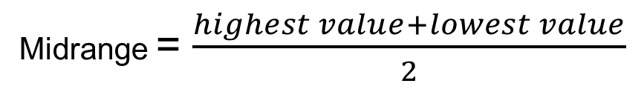
Midrange
The midrange is the value midway between the highest and the lowest values in the data set.
It is found by calculating the average between the highest and the lowest values.
Is the midrange sensitive to outliers?
Midrange = $\frac{highest value+lowest value}{2}$

Slide 12
The mode
Mode - This is the most frequently occurring value in the distribution

Slide 13
Mean = 6.19 m (without outlier)
Mean = 8.10 m
Source: http://www.forestlearn.org/forests/refor.htm
median: (6.0 + 7.1) = 6.55 m
# | Tree Height (m) |  | # | Tree Height (m)
1 | 4.5 |  | 6 | 7.1
2 | 4.8 |  | 7 | 7.5
3 | 5.0 |  | 8 | 7.5
4 | 5.3 |  | 9 | 8.0
5 | 6.0 |  | 10 | 25.4
The mode is : 7.5 m

Slide 14
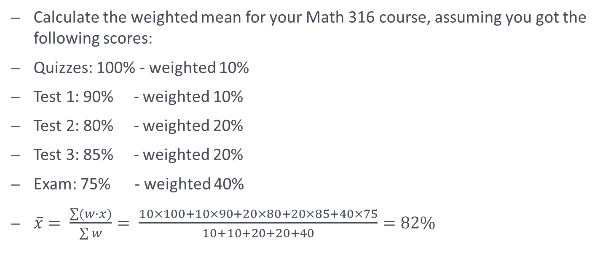
Weighted mean – when do we use it?
Calculate the weighted mean for your Math 316 course, assuming you got the following scores:
Quizzes: 100% - weighted 10%
Test 1: 90% - weighted 10%
Test 2: 80% - weighted 20%
Test 3: 85% - weighted 20%
Exam: 75% - weighted 40%
$\overline{x}= \frac{\sum{(w∙x)}}{\sum{w}}= \frac{10×100+10×90+20×80+20×85+40×75}{10+10+20+20+40}=82\%$

Slide 15
Which one is better: mean, median, or mode?
Consider a company that has nine employees with salaries of 35,000 a year, and the manager’s salary is 150,000 a year.
If you want to describe the typical salary in the company, which statistics will you use?
I will use mode or median (35,000), because it tells what salary most people get
Source: http://www.shodor.org/interactivate/discussions/sd1.html

Slide 16
Which one is better: mean, median, or mode?
Consider a company that has nine employees with salaries of 35,000 a year, and their manager’s salary is 150,000 a year
What if you are a recruiting officer for the company that wants to make a good impression on a prospective employee?
The mean is (35,000*9 + 150,000)/10 = 46,500 I would probably say: "The average salary in our company is 46,500" using mean
Source: http://www.shodor.org/interactivate/discussions/sd1.html

Slide 17
Practice
1. The following data has been collected showing the amount of time (in minutes) students travel from residence to the campus per day:
12 10 23 24 15 16 10 7
Find:
A) The mean
B) The median
C) The mode
D) The midrange

Slide 19
Order the data: 7 10 10 12 15 16 23 24 Mean: 14.625 Median: 13.5 Midrange: 15.5 Mode: 10

Slide 20
Measures of variation or dispersion

Slide 21
Sometimes measures of central tendency are not able to describe a set of data accurately enough, due to the different range of spread of the values for that particular data.
Q 1) For the 2 sets of data below, what are the values of mean and median?
Q 2) Are the 2 sets identical or similar?
Mean: 1st set: 2nd set:
Median: 1st set: 2nd set:
Single line | 6.5 | 7.0 | 8.2 | 9.2 | 5.8
Individual lines | 6.8 | 6.9 | 7.0 | 7.8 | 8.2

Slide 23

The range
The range R for a collection of data values is the difference between the highest (H) and the lowest (L) data values.
$R=H−L$

Slide 24
Calculate the range for the following 2 sets of data, then draw a dot plot for each set. What do you notice?
Set 1: The list of the number of books History students read for research purposes is shown below:
6, 11, 5, 1, 6, 6, 7, 5, 7, 6.
Set 2: The list of the books that Sociology students read for research purposes is shown below:
10, 3, 9, 2, 2, 11, 2, 1, 9, 11.

Slide 25
Set I: 6, 11, 5, 1, 6, 6, 7, 5, 7, 6. Set II:10, 3, 9, 2, 2, 11, 2, 1, 9, 11

Slide 27
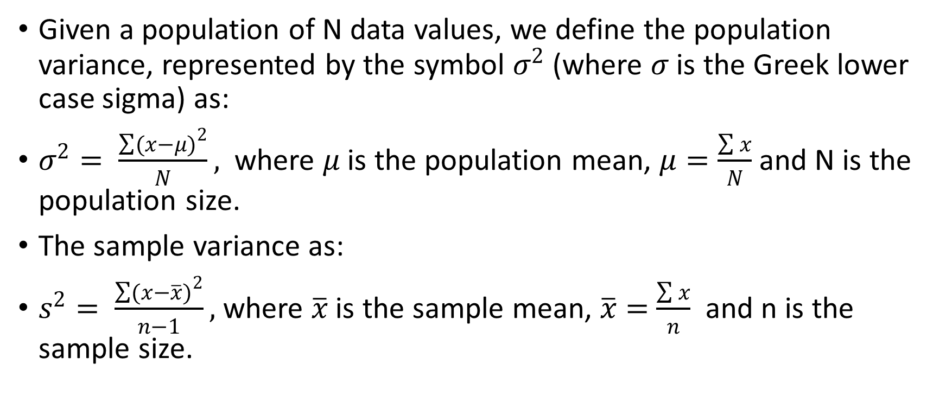
Population and sample variance
Given a population of N data values, we define the population variance, represented by the symbol $σ^{2}$ (where $σ$ is the Greek lower case sigma) as:
$σ^{2}= \frac{\sum{{(x−μ)}^{2}}}{N},$where $μ$ is the population mean, $μ=\frac{\sum{x}}{N}$ and N is the population size.
The sample variance as:
$s^{2}= \frac{\sum{{(x−\overline{x})}^{2}}}{n−1},$where $\overline{x}$ is the sample mean, $\overline{x}=$ $\frac{\sum{x}}{n}$ and n is the sample size.

Slide 28
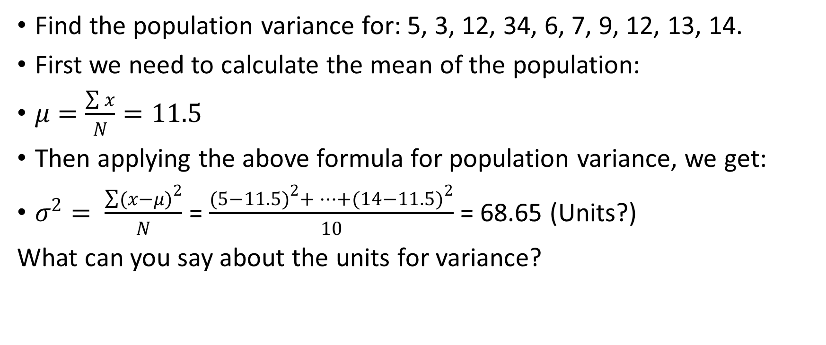
Example
Find the population variance for: 5, 3, 12, 34, 6, 7, 9, 12, 13, 14.
First we need to calculate the mean of the population:
$μ=\frac{\sum{x}}{N}=11.5$
Then applying the above formula for population variance, we get:
$σ^{2}= \frac{\sum{{(x−μ)}^{2}}}{N}$ = $\frac{{(5−11.5)}^{2}+…+{(14−11.5)}^{2}}{10}$ = 68.65 (Units?)
What can you say about the units for variance?

Slide 29
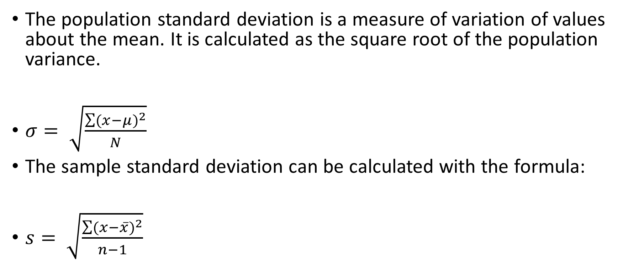
Population and sample standard deviation
The population standard deviation is a measure of variation of values about the mean. It is calculated as the square root of the population variance.
$σ= \sqrt{\frac{\sum{{(x−μ)}^{2}}}{N}}$
The sample standard deviation can be calculated with the formula:
$s= \sqrt{\frac{\sum{{(x−\overline{x})}^{2}}}{n−1}}$

Slide 30

Another formula that can be used for calculating the sample standard deviation is:
$s=\sqrt{\frac{n\sum{{(x)}^{2}−{(\sum{x)}}^{2}}}{n(n−1)}}$

Slide 31
Are measures of variation sensitive to outliers? Let’s check!
Calculate the mean, the variance, and the standard deviation for the following set of data:
8, 13, 14, 16, 61

Slide 32
Order the data: 8, 13, 14, 16, 61

Slide 33
With the outlier
Mean: 22.4
Median: 14
Midrange: 34.5
Variance, s^2: 474.3
St. Dev., s: 21.77843
Range: 53

Slide 34
Without the outlier
Mean: 12.75
Median: 13.5
Midrange: 12
Variance, s^2: 11.58333
St. Dev., s: 3.40343
Range: 8

Slide 35
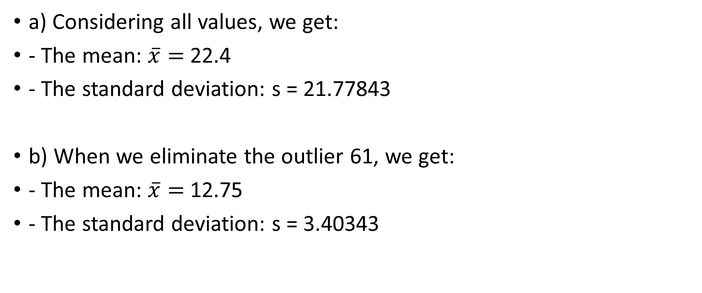
Conclusion???
a) Considering all values, we get:
- The mean: $\overline{x}=$ 22.4
- The standard deviation: s = 21.77843
b) When we eliminate the outlier 61, we get:
- The mean: $\overline{x}=$ 12.75
- The standard deviation: s = 3.40343

Slide 36
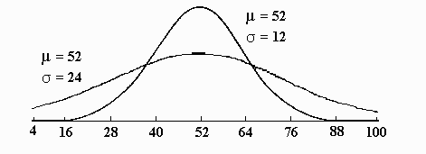
Interpreting the Concept of Dispersion
The taller curve has less dispersion.
The flatter curve has more dispersion.

Slide 37
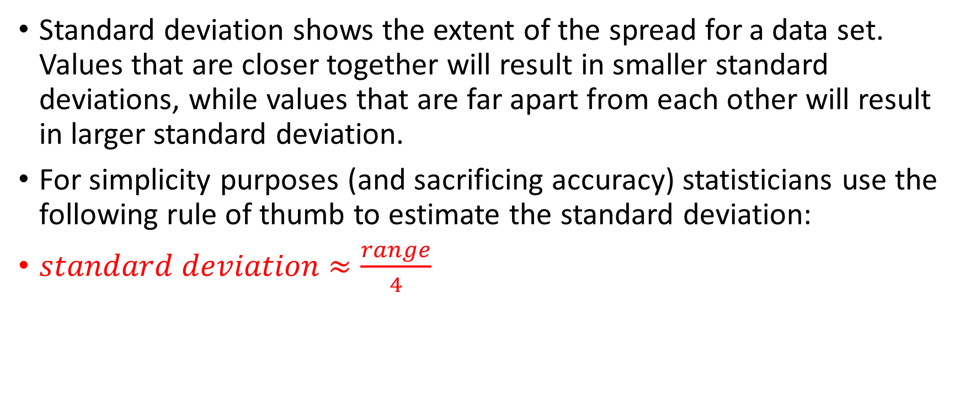
How do we interpret standard deviation?
Standard deviation shows the extent of the spread for a data set. Values that are closer together will result in smaller standard deviations, while values that are far apart from each other will result in larger standard deviation.
For simplicity purposes (and sacrificing accuracy) statisticians use the following rule of thumb to estimate the standard deviation:
$standard deviation$ $≈\frac{range}{4}$

Slide 38
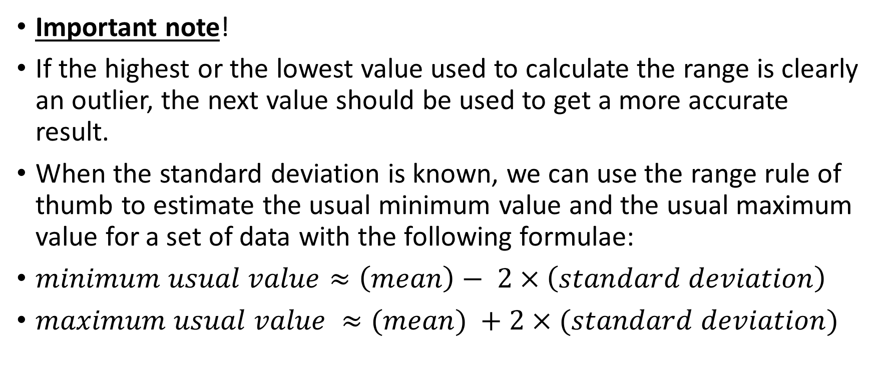
Important note!
If the highest or the lowest value used to calculate the range is clearly an outlier, the next value should be used to get a more accurate result.
When the standard deviation is known, we can use the range rule of thumb to estimate the usual minimum value and the usual maximum value for a set of data with the following formulae:
$minimum usual value≈\left(mean\right)− 2×\left(standard deviation\right)$
$maximum usual value ≈(mean) +2×(standard deviation)$

Slide 39
The empirical rule
This rule applies only to bell-shaped distributions and states that:
a) About 68% of all scores fall within 1 standard deviation of the mean.
b) About 95% of all scores fall within 2 standard deviations of the mean.
c) About 99.7% of all scores fall within 3 standard deviations of the mean.

Slide 40
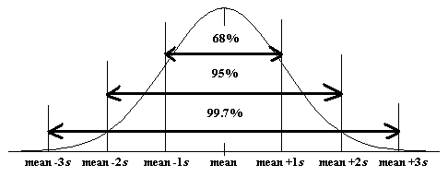
Empirical rule representation

Slide 41
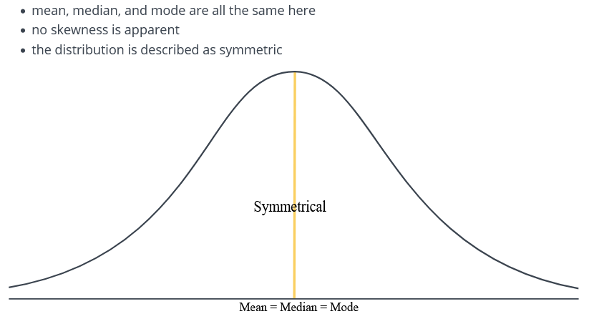
Relationship between the shape of distribution and the measures of central tendency. 1. Symmetrical or normal distribution

Slide 42
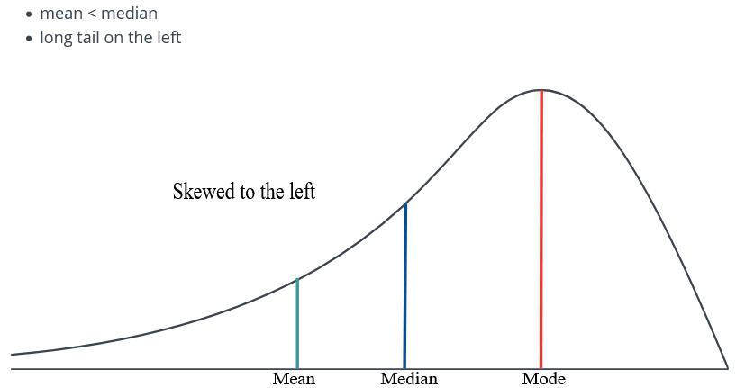
2. Skewed to the left

Slide 43
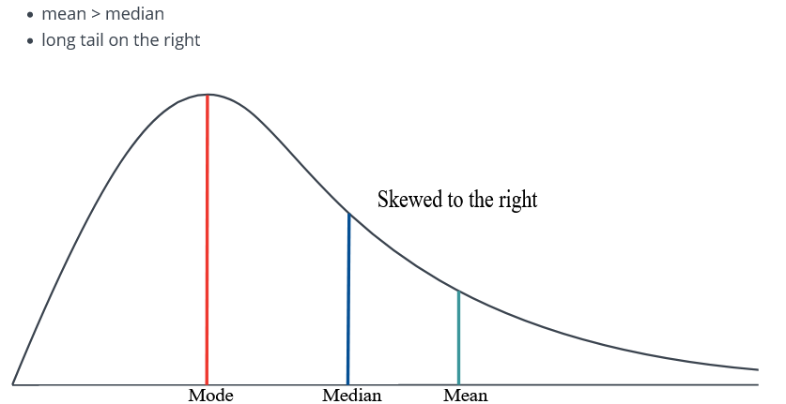
3. Skewed to the right

Slide 44
Practice
The following data has been collected showing the amount of time (in minutes) students travel from residence to the campus per day:
12 10 23 24 15 16 10 7
Find:
A) The range
B) The standard deviation

Slide 46
Answers
Variance, s^2: 38.26786
St. Dev., s: 6.186102
Range: 17

Slide 47
Practice True or False?
1. Some sets of data do not have a mean.
2. There is always a mode for each set of data.
3. The median is always a number in the data set.

Slide 48
It is possible that a distribution of scores could have more than one:
A. Mode.
B. Median.
C. Standard deviation.
D. Mean.

Slide 49
Because it uses every score in a distribution and is easy to interpret, the ___________ is the most common measure of variability.
A. Variance
B. Mean
C. Range
D. Standard deviation

Slide 50
A professor examined the Math scores of the first-year students in his statistics class to see the variability. He found the variance to be 14400. What is the standard deviation?
A. 120
B. 1440
C. 2,073,600
D. 570

